Slide 1

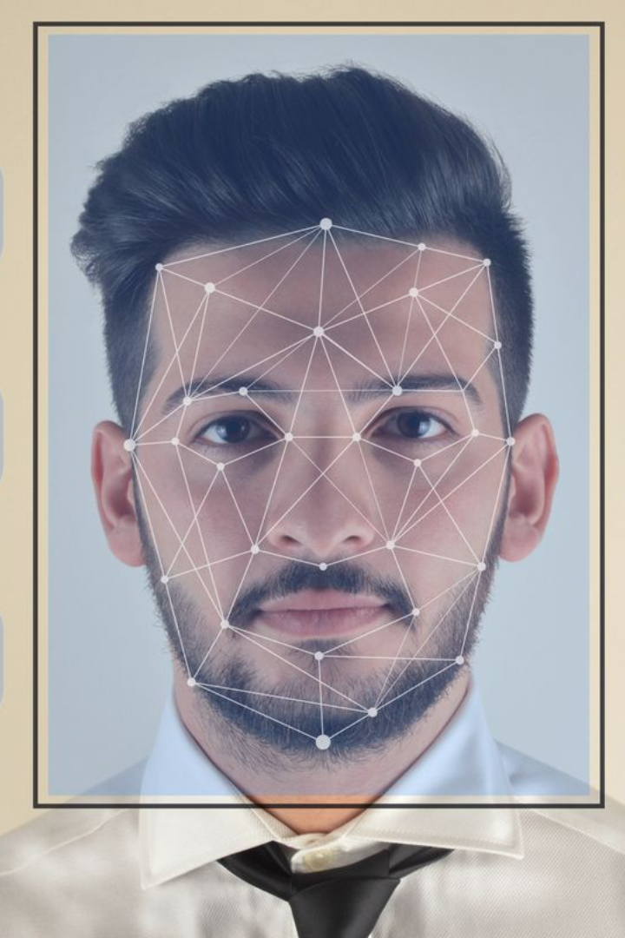
Unveiling the Biases in Facial Recognition Technology
Explore the challenges and biases associated with facial recognition technology in passport photos. Delve into real-life cases and discuss the broader implications and ethical considerations.
Biraj Shrestha

Slide 2

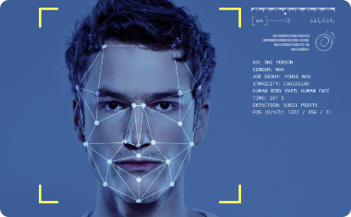

Case Study: The Rejected Passport Photo
Discover the compelling story of a 22-year-old New Zealand engineering student whose passport photo was erroneously rejected by facial recognition technology. Unveil the biases and the impact on individuals.
A 22-year-old New Zealand engineering student
Bias in facial recognition systems
Ethnicity-based errors on dark-skinned women
Uncover the underlying challenges that contribute to errors in facial recognition technology.
Learn how her passport photo was rejected due to flaws in facial recognition technology.
Examine the biased outcomes affecting dark-skinned women specifically in the UK.

Slide 3

The Impact on Society: Broader Implications
Understand the significance of biased facial recognition systems on society and the potential consequences of relying on flawed technology.
1
Societal Implications
2
Ethical Considerations
Discover how biased facial recognition can perpetuate discrimination and hinder social inclusion.
Explore the ethical dilemmas surrounding the use of facial recognition technology and its consequences.
3
Data Security and Privacy
Discuss the potential risks associated with the misuse of facial recognition data and privacy concerns.

Slide 4

The Need for Improvement in Facial Recognition Systems
Highlight the importance of developing fair and accurate facial recognition systems. Address the technological advancements needed to mitigate biases.
1
Enhancing Accuracy
Investigate the advancements necessary to improve the accuracy of facial recognition technology.
Reducing Bias
2
Discuss strategies to minimize biases in facial recognition systems and ensure equal treatment for all.
3
Ethical Frameworks
Explore the development of ethical guidelines to govern the use and implementation of facial recognition technology.

Slide 5
Encouraging Awareness and Dialogue
Emphasize the importance of raising awareness about facial recognition biases and advocate for open discussions to address these challenges collectively.
Education & Awareness
Cross-Sector Collaboration
Promote educational initiatives to increase public understanding of facial recognition biases.
Encourage collaborations between technology experts, policymakers, and civil society to work towards fair and inclusive facial recognition systems.

Slide 6

Conclusion: A Path to Inclusion and Fairness
Summarize the main points discussed, highlighting the need for action to create a more inclusive and fair technological landscape.
1
Acknowledge Biases
2
Advocate for ongoing research, advancements, and conversations to mitigate biases and develop fair facial recognition systems.
Recognize the biases present in facial recognition technology and their impact on individuals and society.

